Slide 1

Usage Funnels with Warby Parker
Learn SQL from Scratch
Jason Brisbane
2/18/19

Slide 2
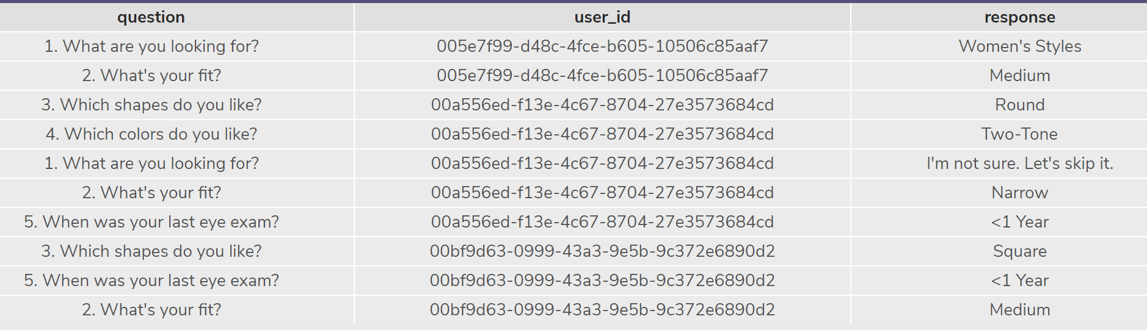
The Perfect Frame – Style Quiz
“What are you looking for ?”
“What’s your fit?”
“Which shapes do you like?”
“Which colors do you like?”
“When was your last eye exam?”

Slide 3
1. Quiz Responses

Slide 4
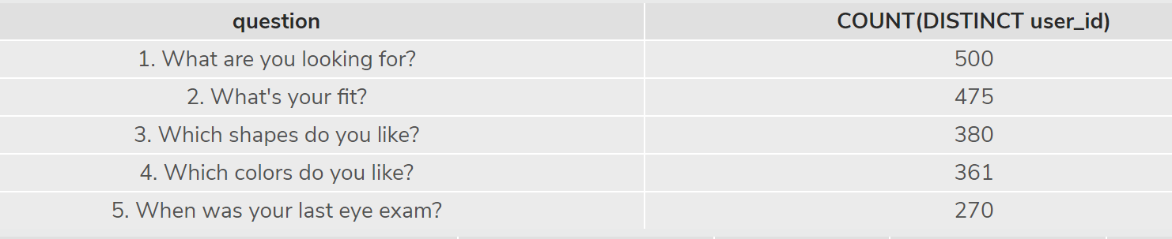
1.Quiz Responses
Question # 1 Received the most responses (500)
Question # 5 Received the least responses (270) and appears to have the lowest completion rate

Slide 5
1.Quiz Responses
Question # 5 may have the lowest completion rate to due privacy concerns regarding exam info
Customers may find the last eye exam question irrelevant in determining the “The Perfect Frame”

Slide 6
1.1 Try-On Funnel Attributes

Slide 7
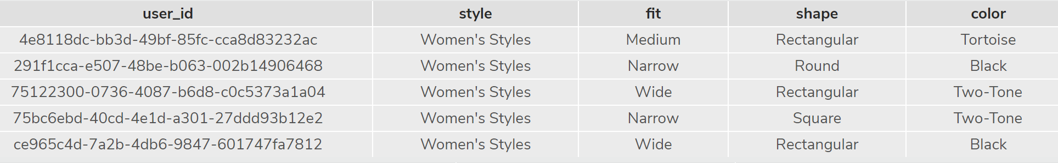
1.1 Try-On Funnel Attributes
Note the below column names for the home try-on funnel
User_id
Style
Fit
Shape
color

Slide 8
1.2 New Table Design

Slide 9
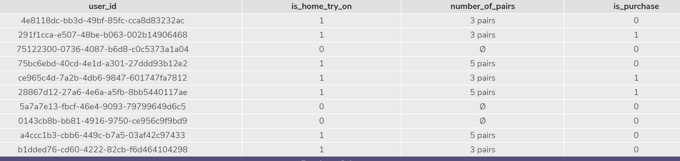
1.2 New Table Design
We designed a new table with the below layout

Slide 10
1.3 Actionable Insights

Slide 11
1.3 Actionable Insights
Based on the findings, Warby Parker should encourage home try to increase the likelihood of purchase

